Slide 1

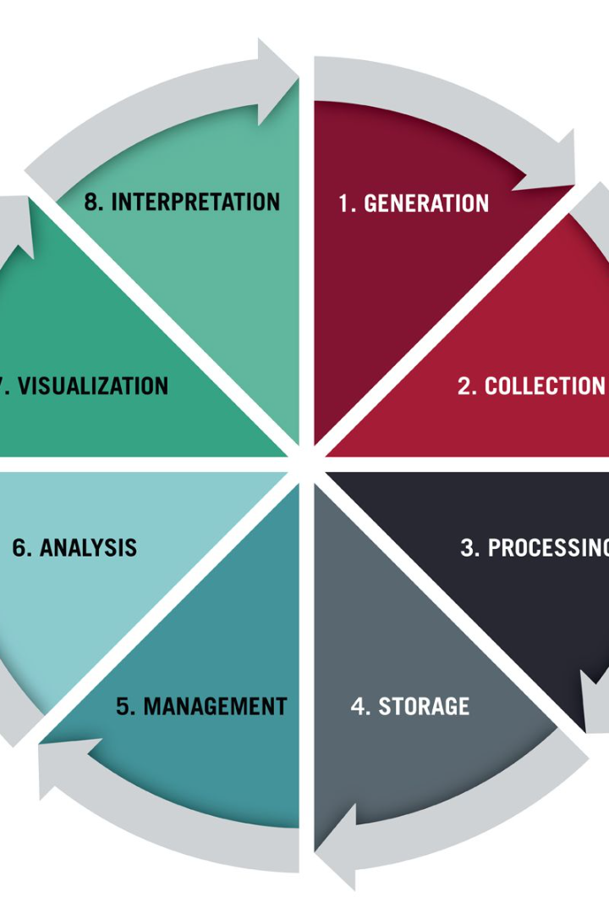
Data Life Cycle
Welcome to our presentation on the Data Life Cycle. In this journey, we will explore the key phases involved in the transformation of data into valuable insights.
KARTHIK. K

Slide 2
Data Generation
Collecting Raw Data
Continuous Data Stream
Data is generated through various sources, such as sensors, surveys, social media, or user interactions.
Data generation is an ongoing process, capturing real-time information from diverse channels.
Data Annotation
Data Quality Assurance
Annotations and metadata are added to the raw data to provide context and improve its interpretability.
Verification and validation processes ensure that the generated data is accurate, complete, and reliable.

Slide 3
Data Collection
1
Data Sources
Data is collected from various structured and unstructured sources, such as databases, files, APIs, and IoT devices.
Data Integration
2
Data from multiple sources is combined and transformed into a unified format for further processing.
3
Data Sampling
In situations where large datasets are involved, representative samples are taken to analyze the data more efficiently.

Slide 4

Data Processing
1
Data Cleansing
2
Data Transformation
Noisy or irrelevant data is identified and removed, ensuring data accuracy and integrity.
Data is converted into a suitable format and structure for analysis, enhancing its accessibility and usability.
3
Data Aggregation
Data is combined, summarized, or grouped to derive meaningful insights and reduce complexity.

Slide 5
Data Storage
On-Premise Storage
Cloud Storage
Data is stored locally within an organization's infrastructure, providing direct control and security.
Data is stored on remote servers, enabling scalability, accessibility, and cost-effective solutions.

Slide 6
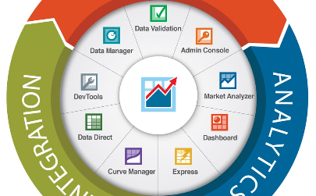

Data Management
Data Governance
Data Integration
Data Visualization
Policies and procedures are implemented to ensure data privacy, security, and compliance.
Data from multiple sources is integrated and combined to create a comprehensive view for analysis and decision-making.
Data is visually represented using charts, graphs, and dashboards, enabling easier interpretation and understanding of trends.

Slide 7
Data Analysis
1
Exploratory Analysis
Data is explored and examined to discover patterns, relationships, and anomalies.
Statistical Analysis
2
Statistical techniques are applied to uncover deeper insights, correlations, and trends within the data.
3
Machine Learning
Advanced algorithms and models are used to identify patterns, make predictions, and automate decision-making.

Slide 8
Data Visualization
Charts and Graphs
Interactive Dashboards
Data Storytelling
Data is visualized using various charts, graphs, and infographics to communicate complex information effectively.
Dynamic and interactive dashboards allow users to explore and interact with data in real-time.
Data is presented in a compelling narrative format, enabling stakeholders to understand and act upon the insights.

Slide 9
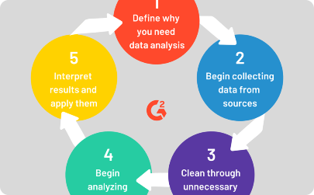

Data Interpretation
Critical Thinking
Decision-Making
Action Planning
Interpreting data requires analytical skills, logical reasoning, and a deep understanding of the subject matter.
Insights gained from data interpretation drive informed decision-making processes.
Data interpretation leads to actionable steps, strategies, and improvements based on the identified opportunities and challenges.

Slide 10
References and Citations:
Hirarchy of needs. (n.d.). Retrieved September 16, 2019, from https://en.wikipedia.org/wiki/Maslow%27s_hierarchy_of_needs
The Data Life Cycle - The Data Science Institute at Columbia University. (2020, September 20). The Data Science Institute at Columbia University. https://datascience.columbia.edu/news/2018/the-data-life-cycle/
8 Steps in the Data Life Cycle | HBS Online. (2021, February 2). Business Insights Blog. https://online.hbs.edu/blog/post/data-life-cycle
THANK YOU!!

